Slide 1
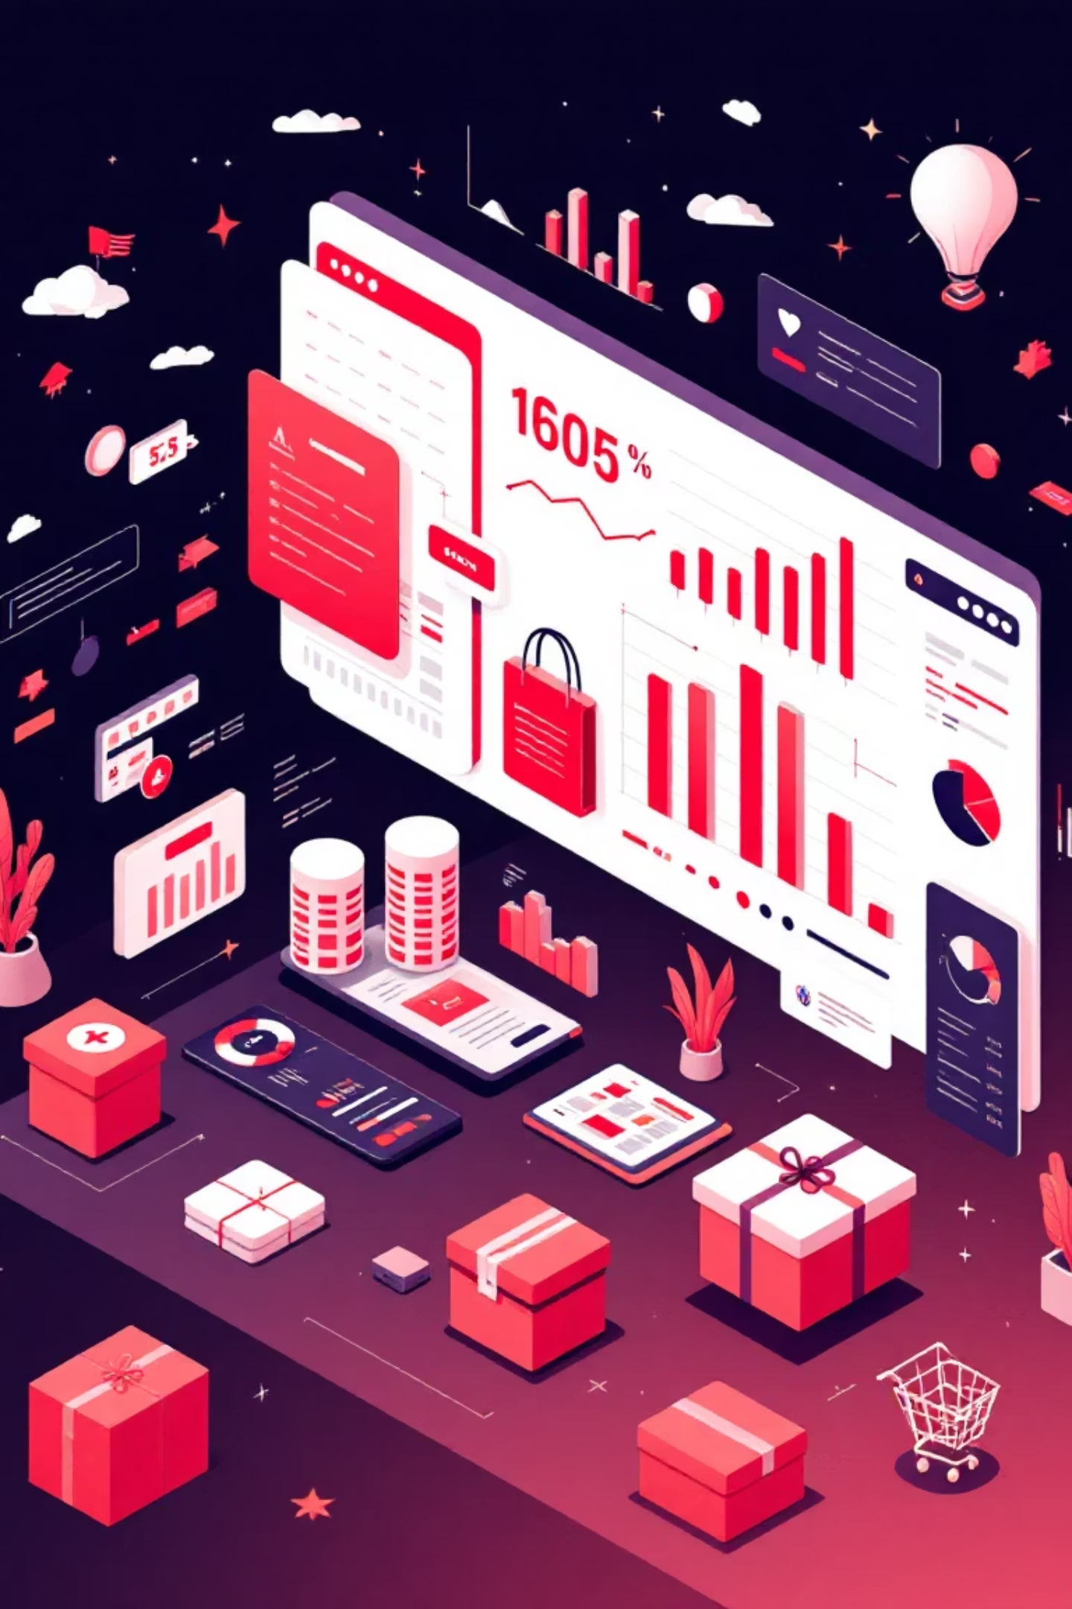
Customer Shopping Behavior Analysis
Uncovering insights from 3,900 customer transactions to drive strategic business decisions through data-driven analysis of spending patterns, customer segments, and product preferences.

Slide 2

Dataset Overview
3,900
18
$60
Total Purchases
Data Columns
Average Purchase
Transactions analyzed across all categories
Comprehensive customer and purchase attributes
Mean transaction value across all customers
50
Locations
Geographic coverage across diverse markets
Our dataset captures rich customer demographics including age, gender, and location, alongside detailed purchase information such as item category, amount, season, size, and color. Shopping behavior metrics include discount usage, promo codes, previous purchases, frequency, review ratings, and shipping preferences.

Slide 3

Data Preparation & Python Analysis
Data Cleaning Process
Feature Engineering
Loaded dataset using pandas for initial exploration
Created age_group column by binning customer ages into segments
Handled 37 missing values in Review Rating using median imputation by category
Generated purchase_frequency_days from transaction data
Standardized column names to snake_case format
Integrated cleaned data into PostgreSQL for advanced SQL analysis
Verified data consistency and removed redundant columns

Slide 4

Revenue Insights by Customer Segment
Male Customers
Female Customers
$157,890 total revenue
$75,191 total revenue
Representing 68% of total sales and demonstrating significantly higher spending patterns
Comprising 32% of total sales with opportunities for targeted growth strategies
High-Value Discount Users
Identified 839 customers who used discounts but still spent above the average purchase amount of $60. These savvy shoppers represent a key segment that responds to promotions while maintaining strong spending levels.

Slide 5
Top-Rated Products & Shipping Preferences
1
2
3
Gloves
Sandals
Boots
Average rating: 3.86
Average rating: 3.84
Average rating: 3.82
4
5
Hat
Skirt
Average rating: 3.80
Average rating: 3.78
Standard Shipping
Express Shipping
Average purchase: $58.46
Average purchase: $60.48
Most popular option among cost-conscious shoppers
Slightly higher spend from customers valuing speed

Slide 6
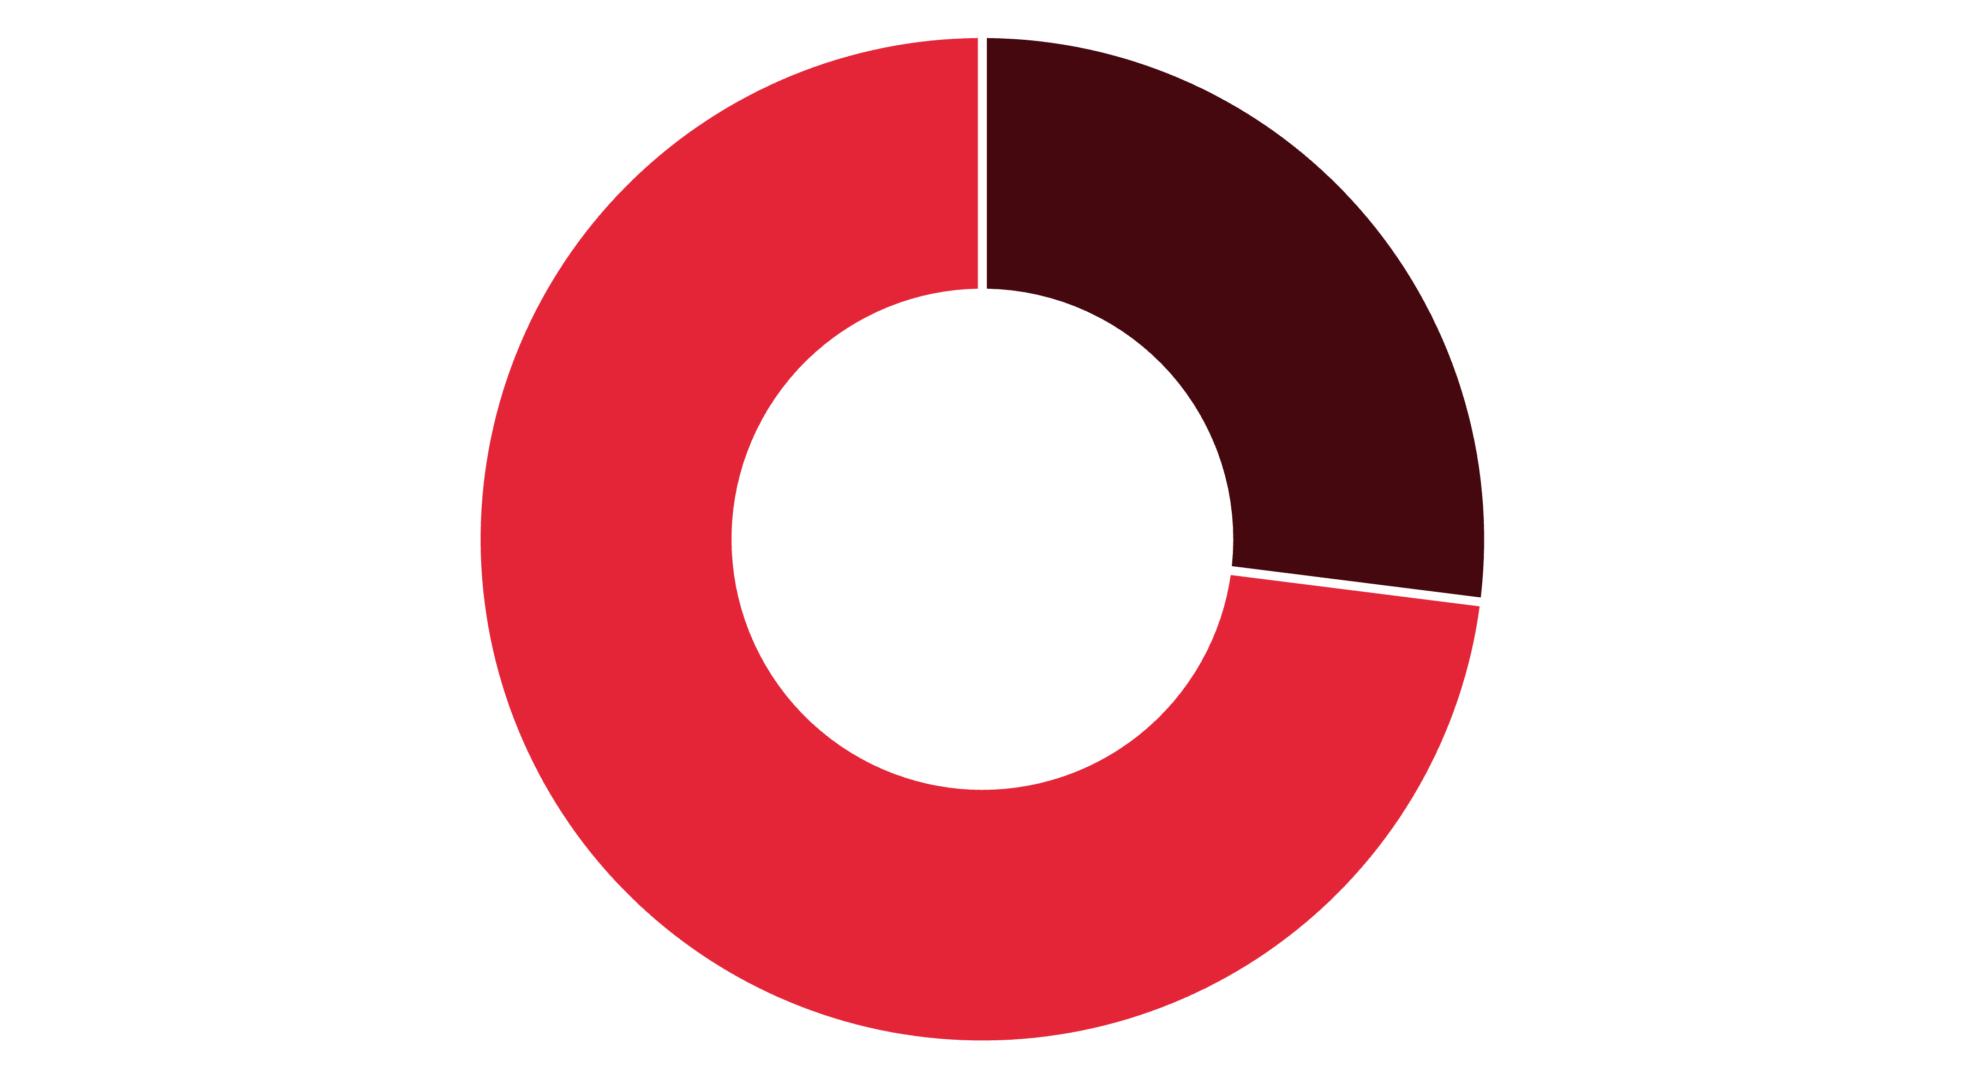
Subscription Status Analysis
Subscribers
Non-Subscribers
Subscribers
Non-Subscribers
Key Insight
1,053 customers
2,847 customers
Non-subscribers represent 73% of the customer base and generate significantly more total revenue, presenting a major opportunity for subscription conversion.
Average spend: $59.49
Average spend: $59.87
Total revenue: $62,645
Total revenue: $170,436

Slide 7
Discount-Dependent Products
Products with the highest percentage of discounted purchases reveal strategic pricing opportunities:
50%
49.66%
49.07%
Hat
Sneakers
Coat
Highest discount rate
Nearly half sold with discount
Strong discount dependency
48.17%
47.37%
Sweater
Pants
Frequent promotional item
High discount utilization

Slide 8
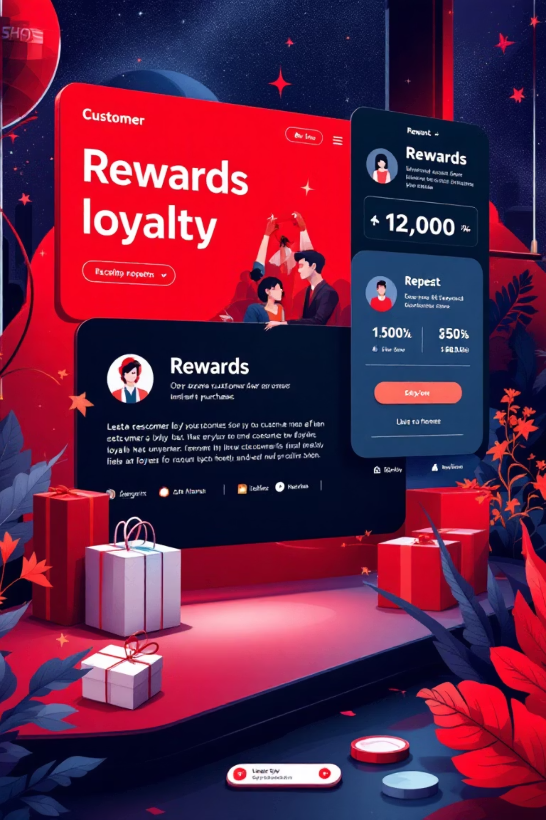

Customer Segmentation & Loyalty
Loyal Customers
Returning Customers
3,116 customers (80%)
701 customers (18%)
Established buying patterns with consistent engagement
Growing relationship with moderate purchase history
New Customers
83 customers (2%)
Fresh acquisitions requiring nurturing strategies
Repeat Buyers & Subscription Correlation
Among customers with more than 5 purchases, 958 are subscribers while 2,518 are non-subscribers. This reveals that even highly engaged repeat buyers aren't converting to subscriptions, indicating untapped potential for subscription growth among our most loyal customers.

Slide 9
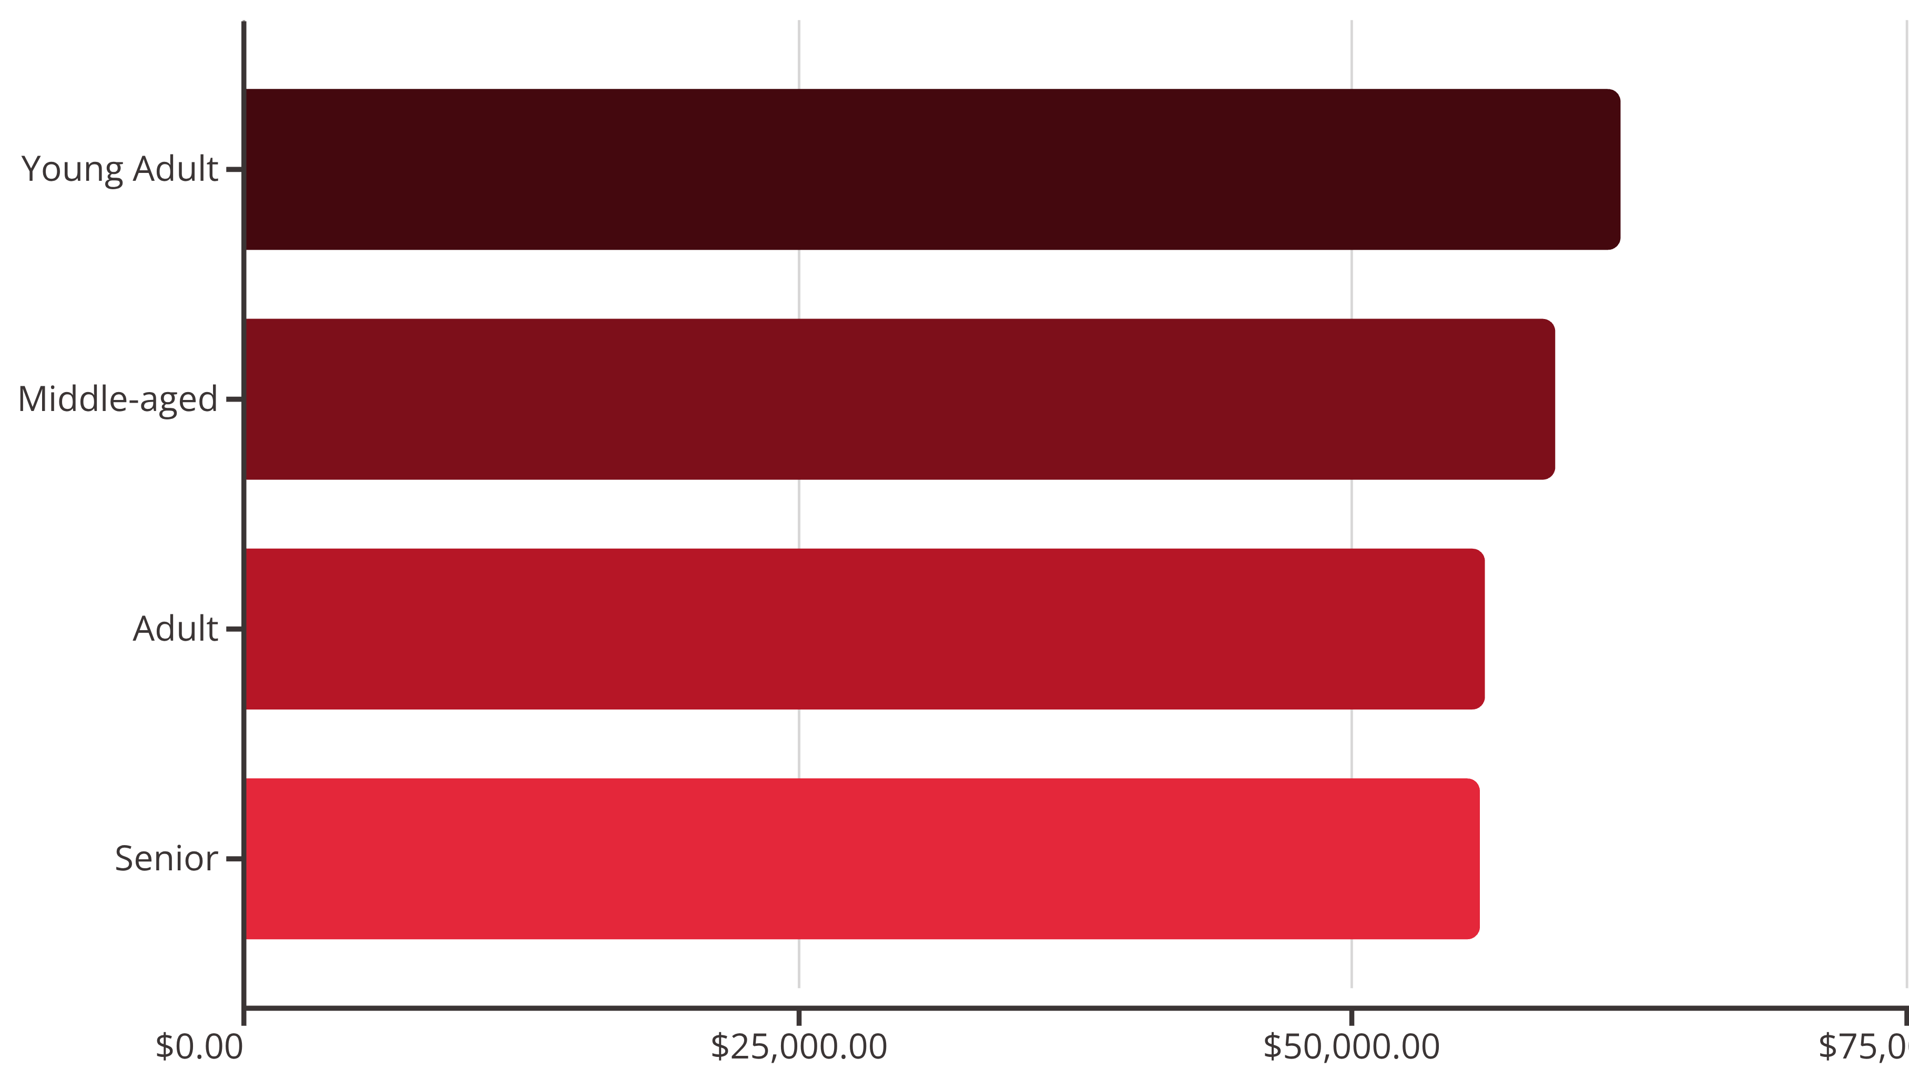
Top Products by Category
Accessories
Clothing
Footwear
Outerwear
Jewelry (171 orders)
Blouse (171 orders)
Sandals (160 orders)
Jacket (163 orders)
Sunglasses (161)
Pants (171)
Shoes (150)
Coat (161)
Belt (161)
Shirt (169)
Sneakers (145)
Revenue by Age Group
Young adults lead revenue generation, followed closely by middle-aged customers, with relatively balanced contributions across all age segments.

Slide 10
Strategic Business Recommendations
01
02
03
Boost Subscription Conversion
Enhance Customer Loyalty Programs
Optimize Discount Strategy
Promote exclusive benefits for subscribers, especially targeting the 2,518 repeat buyers who aren't yet subscribed. Focus on value propositions that resonate with loyal customers.
Review discount policy for products with 47-50% discount rates. Balance promotional sales boosts with margin control to maintain profitability while driving volume.
Reward repeat buyers to accelerate their journey into the "Loyal" segment. Implement tiered benefits that recognize and incentivize increasing purchase frequency.
04
05
Leverage Product Performance
Execute Targeted Marketing
Highlight top-rated products (Gloves, Sandals, Boots) and best-sellers in marketing campaigns. Position these items prominently to capitalize on proven customer satisfaction.
Focus efforts on high-revenue age groups (Young Adults, Middle-aged) and customers who prefer express shipping, as they demonstrate higher spending patterns and urgency.

